Slide 1
CE111: Engineering Drawing
Lecture 9:
Projection of Points and Lines

Slide 2
2nd Quadrant
VP
2nd Quad.
1ST Quad.
F.V.
1st Quadrant
Y
Observer
X Y
HP
X
3rdQuadrant
Observer
3rd Quad.
4th Quad.
4th Quadrant
THIS QUADRANT PATTERN,
IF OBSERVED ALONG X-Y LINE ( IN RED ARROW DIRECTION)
WILL EXACTLY APPEAR AS SHOWN ON RIGHT SIDE AND HENCE,
IT IS FURTHER USED TO UNDERSTAND ILLUSTRATION PROPERLLY.

Slide 3
NOTATIONS
FOLLOWING NOTATIONS SHOULD BE FOLLOWED WHILE NAMEING
DIFFERENT VIEWS IN ORTHOGRAPHIC PROJECTIONS.
OBJECT POINT A LINE AB
IT’S TOP VIEW a a b
IT’S FRONT VIEW a` a` b`
IT’S SIDE VIEW a`` a``b``
SAME SYSTEM OF NOTATIONS SHOULD BE FOLLOWED
INCASE NUMBERS, LIKE 1, 2, 3 – ARE USED.

Slide 4
PROJECTIONS OF STRAIGHT LINES
Locus of a point, which moves linearly the shortest distance between any two given points
Information regarding a line means
It’s length,
Position of it’s ends with HP & VP
It’s inclinations with HP & VP
Aim:- to draw it’s projections - means FV & TV.
SIMPLE CASES OF THE LINE
A VERTICAL LINE ( LINE PERPENDICULAR TO HP & PARALLEL TO VP)
LINE PARALLEL TO BOTH HP & VP.
LINE INCLINED TO HP & PARALLEL TO VP.
LINE INCLINED TO VP & PARALLEL TO HP.
LINE INCLINED TO BOTH HP & VP.

Slide 5
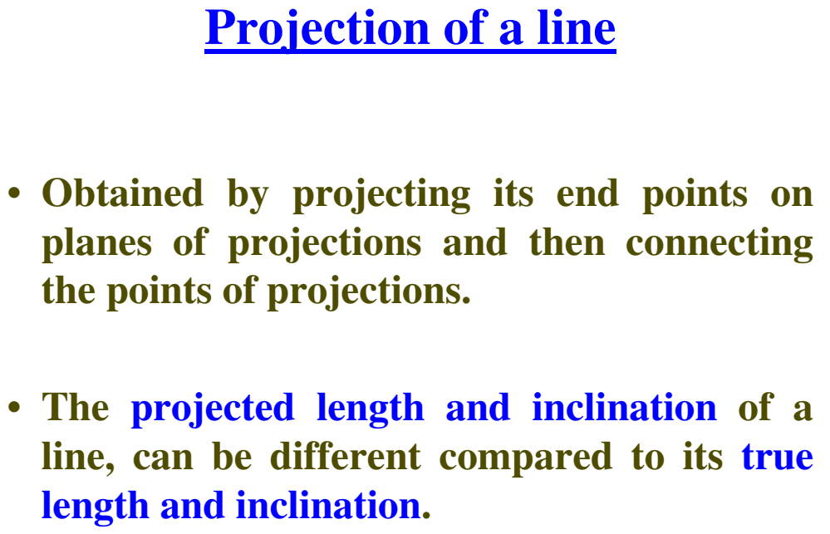

Slide 6
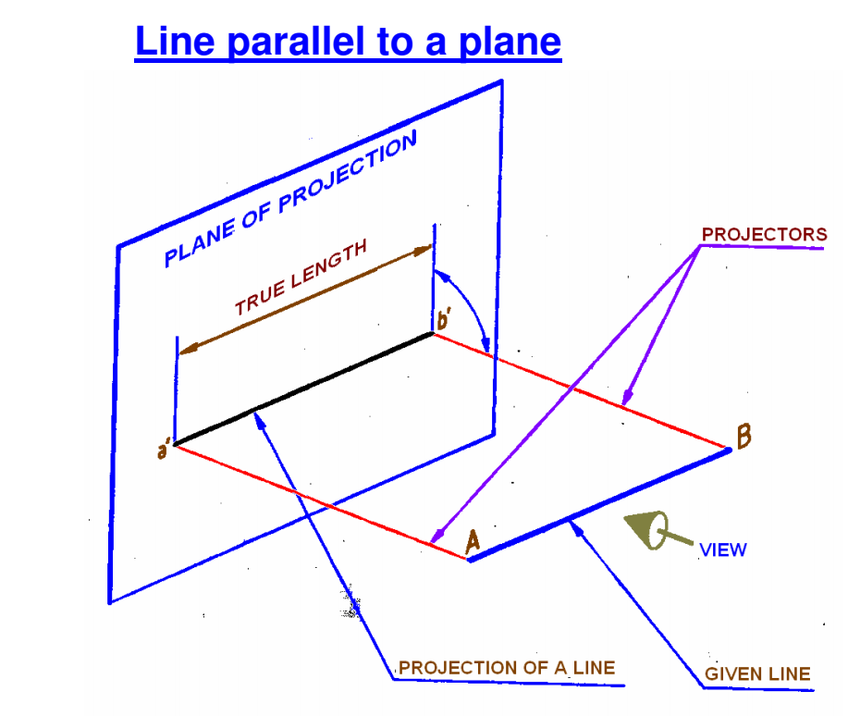

Slide 7
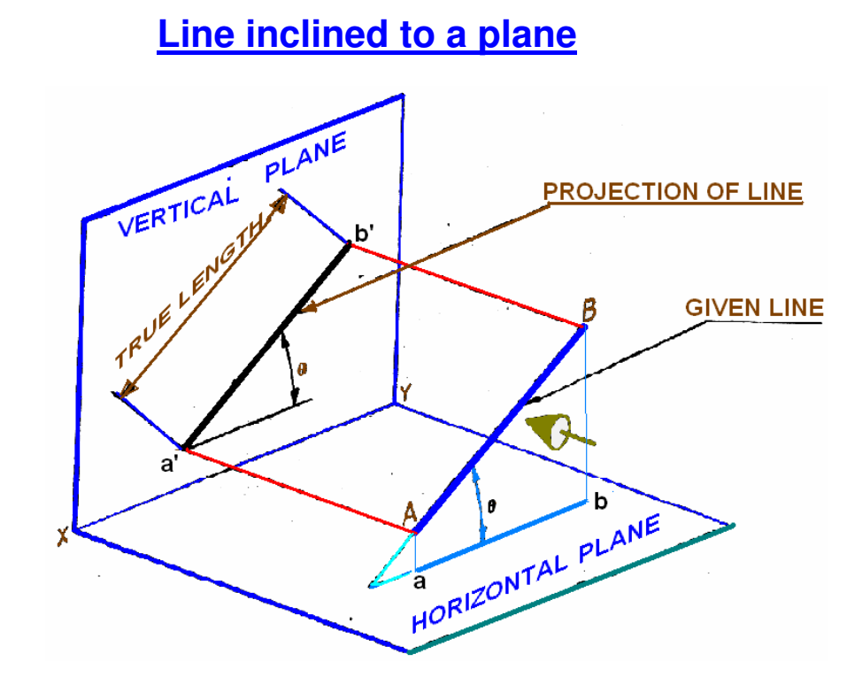

Slide 8
For Tv
Orthographic Pattern
(Pictorial Presentation)
V.P.
a’
Note:
Fv is a vertical line
Showing True Length
&
Tv is a point.
a’
1.
V.P.
A
Fv
FV
A Line
perpendicular
to Hp
&
// to Vp
b’
b’
Y
X
Y
B
For Fv
TV
a(b)
X
Tv
a(b)
H.P.
Orthographic Pattern
(Pictorial Presentation)
Note:
Fv & Tv both are
// to xy
&
both show T. L.
V.P.
For Tv
2.
a’
Fv
b’
V.P.
b’
A Line
// to Hp
&
// to Vp
F.V.
B
a’
A
Y
X
Y
For Fv
b
a
b
T.V.
Tv
X
a
H.P.

Slide 9
Fv inclined to xy
Tv parallel to xy.
V.P.
3.
V.P.
b’
b’
A Line inclined to Hp
and
parallel to Vp
(Pictorial presentation)
B
F.V.
F.V.
a’
θ
θ
Y
X
Y
a’
θ
A
b
a
T.V.
b
X
T.V.
True Angle/Inclination with HP = θ
a
H.P.
Orthographic Projections
Tv inclined to xy
Fv parallel to xy.
V.P.
4.
V.P.
Fv
A Line inclined to Vp
and
parallel to Hp
(Pictorial presentation)
F.V.
b’
a’
b’
a’
A
Ø
B
X
Y
a
Ø
a
Ø
b
Tv
T.V.
True Angle/Inclination with VP = ϕ
b
H.P.

Slide 10
For Tv
For Tv
5.
A Line inclined to both
Hp and Vp
(Pictorial presentation)
b’
b’
V.P.
V.P.
B
F.V.
B
F.V.
α
α
Y
Y
On removal of object
i.e. Line AB
Fv as a image on Vp.
Tv as a image on Hp,
a’
a’
For Fv
For Fv
A
A
β
X
β
X
a
T.V.
b
a
T.V.
b
V.P.
b’
Apparent Angle with the HP = α
Apparent Angle with the VP = β
FV
a’
α
X
Y
Orthographic Projections
Fv is seen on Vp clearly.
To see Tv clearly, HP is rotated 90⁰ downwards,
Hence it comes below xy.
Note These Facts:-
Both Fv & Tv are inclined to xy.
(No view is parallel to xy)
Both Fv & Tv are reduced lengths.
(No view shows True Length)
a
β
TV
H.P.
b

Slide 11
Orthographic Projections
Means Fv & Tv of Line AB
are shown below,
with their apparent Inclinations
α & β
Note the procedure
When Fv & Tv known,
How to find True Length.
(Views are rotated to determine
True Length & it’s inclinations
with HP & VP).
Note the procedure
When True Length is known,
How to locate Fv & Tv.
(Component a-1 of TL is drawn
which is further rotated
to determine Fv)
V.P.
V.P.
V.P.
b’
b’
b₁’
b’
b₁’
FV
FV
Fv
TL
a’
α
TL
a’
θ
α
a’
θ
1’
X
Y
X
Y
X
Y
a
1
a
β
a
β
TV
b₁
Ø
β
TV
TV
Tv
TL
H.P.
b
H.P.
b
H.P.
b
b₁
Here TV (ab) is not // to XY line
Hence it’s corresponding FV
a’ b’ is not showing
True Length &
True Inclination with HP.
In this sketch, TV is rotated
and made // to XY line.
Hence it’s corresponding
FV a’ b₁’ Is showing
True Length
&
True Inclination with HP.
Here a -1 is component
of TL ab₁ gives length of Fv.
Hence it is brought Up to
Locus of a’ and further rotated
to get point b’. a’ b’ will be Fv.
Similarly drawing component
of other TL(a’ b₁‘) Tv can be drawn.

Slide 12
The most important diagram showing graphical relations
among all important parameters of this topic.
Study and memorize it as a CIRCUIT DIAGRAM
And use in solving various problems.
1) True Length ( TL) – a’ b₁’ & a b₁
2) Angle of TL with Hp -
θ
Important
TEN parameters
to be remembered
with Notations
used here onward
3) Angle of TL with Vp –
Ø
4) Angle of FV with xy –
α
V.P.
5) Angle of TV with xy –
β
Distance between
End Projectors.
6) LFV (length of FV) – Component (a-1)
b’
b₁’
7) LTV (length of TV) – Component (a’-1’)
8) Position of A- Distances of a & a’ from xy
Fv
TL
9) Position of B- Distances of b & b’ from xy
α
10) Distance between End Projectors
a’
θ
1’
LTV
NOTE this
θ
&
α
Construct with a’
X
Y
a
LFV
1
Ø
&
β
Construct with a
Ø
b’ & b₁’ on same locus.
β
b & b₁ on same locus.
Tv
TL
b₁
Also Remember
H.P.
b
True Length is never rotated. It’s horizontal component is drawn & it is further rotated to locate view.
Views are always rotated, made horizontal & further extended to locate TL, θ & Ø

Slide 13
GROUP (A)
GENERAL CASES OF THE LINE INCLINED TO BOTH HP & VP
( based on 10 parameters).
PROBLEM:
Line AB is 75 mm long and it is 30⁰ &
40⁰ Inclined to HP & VP respectively.
End A is 12mm above HP and 10 mm
in front of VP.
Draw projections. Line is in 1st quadrant.
b’
b’₁
SOLUTION STEPS:
1) Draw xy line and one projector.
2) Locate a’ 12mm above xy line
& a 10mm below xy line.
3) Take 30⁰ angle from a’ & 40⁰ from
a and mark TL I.e. 75mm on both
lines. Name those points b₁’ and b₁
respectively.
4) Join both points with a’ and a resp.
5) Draw horizontal lines (Locus) from
both points.
6) Draw horizontal component of TL
a b₁ from point b₁ and name it 1.
( the length a-1 gives length of Fv as we have seen already.)
7) Extend it up to locus of a’ and rotating a’ as center locate b’ as shown. Join a’ b’ as Fv.
8) From b’ drop a projector down ward & get point b. Join a & b I.e. Tv.
FV
TL
θ
a’
X
Y
a
LFV
Ø
1
TV
TL
b
b₁

Slide 14
PROBLEM:
Line AB 75mm long makes 45⁰ inclination with VP while it’s Fv makes 55⁰ to the XY line.
End A is 10 mm above HP and 15 mm in front of VP. If line is in 1st quadrant
draw it’s projections and find it’s inclination with HP.
b’
b’₁
LOCUS OF b₁’
Solution Steps:-
1.Draw x-y line.
2.Draw one projector for a’ & a
3.Locate a’ 10mm above x-y &
Tv a 15 mm below xy.
4.Draw a line 45⁰ inclined to xy
from point a and cut TL 75 mm
on it and name that point b₁
Draw locus from point b₁
5.Take 55⁰ angle from a’ for Fv
above xy line.
6.Draw a vertical line from b₁
up to locus of a and name it 1.
It is horizontal component of
TL & is LFV.
7.Continue it to locus of a’ and
rotate upward up to the line
of Fv and name it b’.This a’ b’
line is Fv.
8. Drop a projector from b’ on
locus from point b₁ and
name intersecting point b.
Line a b is Tv of line AB.
9.Draw locus from b’ and from
a’ with TL distance cut point b₁‘
10.Join a’ b₁’ as TL and measure
it’s angle at a’.
It will be true angle of line with HP.
FV
TL
55⁰
a’
X
y
a
LFV
1
Φ 45⁰
TV
TL
LOCUS OF b
b
b₁

Slide 15
PROBLEM : Fv of line AB is 50⁰ inclined to the XY line and measures 55 mm long, while it’s Tv is 60⁰ inclined to the XY line. If end A is 10 mm above HP and 15 mm in front of VP, draw it’s projections, find TL, inclinations of line with HP & VP.
b’
b’₁
SOLUTION STEPS:
1.Draw xy line and one projector.
2.Locate a’ 10 mm above xy and
a 15 mm below xy line.
3.Draw locus from these points.
4.Draw Fv 50⁰ to xy from a’ and
mark b’ Cutting 55mm on it.
5.Similarly draw Tv 60⁰ to xy
from a & drawing projector from b’
Locate point b and join a b.
6.Then rotating views as shown,
locate True Lengths ab₁ & a’b₁’
and their angles with Hp and Vp.
FV
TL
50⁰
θ
X
a’
y
a
Φ
60⁰
TL
b₁
b

Slide 16
PROBLEM :
T.V. of a 75 mm long Line CD, measures 50 mm in TV.
End C is in HP and 50 mm in front of VP.
End D is 15 mm in front of VP and it is above HP.
Draw projections of CD and find angles with HP and VP.
d’
d’₁
LOCUS OF d’ & d’₁
SOLUTION STEPS:
1.Draw the XY line and one projector.
2.Locate c’ on XY and c 50mm below XY line.
3.Draw locus from these points.
4.Draw locus of d 15 mm below XY 5.
Cut 50 mm & 75 mm distances on
locus of d from c and mark points
d & d₁ as these are Tv and line CD
lengths resp.& join both with c.
6.From d₁ draw a vertical line upward
up to XY I.e. up to locus of c’ and
draw an arc as shown.
7 Then draw one projector from d to
meet this arc in d’ point & join c’ d’
8. Draw locus of d’ and cut 75 mm
on it from c’ as TL
9.Measure Angles θ & ϕ
FV
TL
X
c’
θ
Y
d
d₁
LOCUS OF d & d₁
TL
TV
c
Φ

Slide 17
GROUP (B)
PROBLEMS INVOLVING TRACES OF THE LINE
TRACES OF THE LINE:-
These are the points of intersections of a line ( or it’s extension )
With respective reference planes.
A line itself or it’s extension, wherever touches the HP,
That point is called trace of the line on HP ( It is called H.T.)
Similarly, a line itself or it’s extension, where ever touches the VP,
That point is called trace of the line on VP ( It is called V.T.)
V.T.:- It is a point on VP.
Hence it is called Fv of a point in VP.
Hence it’s Tv comes on XY line. ( Here onward named as ‘v’)
H.T.:- It is a point on HP.
Hence it is called Tv of a point in HP.
Hence it’s Fv comes on XY line. ( Here onward named as ‘h’)

Slide 18
b’
STEPS TO LOCATE HT.
(WHEN PROJECTIONS ARE GIVEN.)
FV
Begin with FV. Extend FV up to XY line.
Name this point h’
( as it is a Fv of a point in Hp)
3. Draw one projector from h’.
4. Now extend Tv to meet this projector.
This point is HT
a’
x
v
h’
y
VT’
HT
a
STEPS TO LOCATE VT.
(WHEN PROJECTIONS ARE GIVEN.)
TV
Observe & note :-
1. Points h’ & v always on x-y line.
2. VT’ & v always on one projector.
3. HT & h’ always on one projector.
4. FV - h’- VT’ always co-linear.
5. TV - v - HT always co-linear.
Begin with TV. Extend TV up to XY line.
Name this point v
( as it is a Tv of a point in Vp)
3. Draw one projector from v.
4. Now extend Fv to meet this projector.
This point is VT
b
These points are used to
solve next three problems.

Slide 19
PROBLEM :- Fv of line AB makes 45⁰ angle with XY line and measures 60 mm.
Line’s Tv makes 30⁰ with XY line. End A is 15 mm above HP and it’s VT is 10 mm
below HP. Draw projections of line AB, determine inclinations with HP & VP and locate HT, VT.
b’
b’₁
a’
θ
45⁰
15
v
SOLUTION STEPS:-
Draw XY line, one projector and
locate fv a’ 15 mm above xy.
Take 45⁰ angle from a’ and
marking 60 mm on it locate point b’.
Draw locus of VT, 10 mm below xy
& extending Fv to this locus locate VT.
as fv-h’-vt’ lie on one st.line.
Draw projector from vt, locate v on xy.
From v take 30⁰ angle downward as
Tv and it’s inclination can begin with v.
Draw projector from b’ and locate b I.e.Tv point.
Now rotating views as usual TL and
it’s inclinations can be found.
Name extension of Fv, touching xy as h’
and below it, on extension of Tv, locate HT.
x
h’
y
10
30⁰
HT
VT’
a
∅
b
b₁

Slide 20
PROBLEM :
One end of line AB is 10 mm above HP and other end is 100 mm in-front of VP.
It’s Fv is 45⁰ inclined to XY while it’s HT & VT are 45 mm and 30 mm below XY respectively.
Draw projections and find TL with it’s inclinations with HP & VP.
b’
b’₁
LOCUS OF b’ & b’₁
FV
TL
a’
θ
45⁰
10
v
h’
Y
X
30
45
VT’
HT
SOLUTION STEPS:-
Draw xy line, one projector and
locate a’ 10 mm above xy.
Draw locus 100 mm below xy for points b & b₁
Draw loci for VT and HT, 30 mm & 45 mm
below xy respectively.
Take 45⁰ angle from a’ and extend that line backward
to locate h’ and VT, & Locate v on xy above VT.
Locate HT below h’ as shown.
Then join v – HT – and extend to get top view end b.
Draw projector upward and locate b’ Make a b & a’b’ dark.
Now as usual rotating views find TL and it’s inclinations.
100
a
Φ
TL
TV
b
b₁
LOCUS OF b & b₁

